Slide 1
Cybersecurity
DNS Poisoning and Domain Hijacking

Slide 2
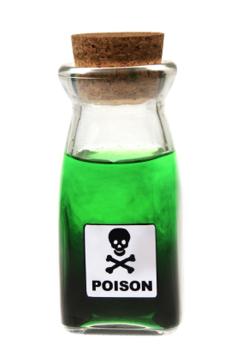
DNS Poisoning
Modify the DNS entries
Hack DNS server
Modify the client hosts file
Every OS has hosts file
Supersedes DNS queries
Send a fake response to valid DNS request
Intercept valid DNS request
Send forged DNS response

Slide 3



Normal DNS Server
What is the IP Address for cyber.org?
What is the IP Address for cyber.org?
IP Address is 184.168.131.241
IP Address is 184.168.131.241
DNS Server

Slide 4
DNS Poisoning
What is the IP Address for cyber.org?
What is the IP Address for cyber.org?
IP Address is 3.13.146.149
cyber.org’s IP Address is 3.13.146.149
DNS Server
cyber.org’s IP Address is 3.13.146.149
IP Address is 3.13.146.149

Slide 5

Domain Hijacking
Gain access to domain registration to control where the traffic flows
No need to attack actual DNS servers
Control associated names and addresses
How to take over an account
Brute force
Social engineer the password
Gain access to the email address that manages the account
Then “forgot my password” on account

Slide 6
Domain Hijacking
Saturday October 22, 2016 1pm
Domain name registrations of 36 domains are changed
Brazilian bank
Desktop domains, mobile domains, and more
Under hacker control for 6 hours
The bad guys became the bank
5 million customers, $27 billion in assets
Results of the hack have not been publicly released

